Slide 1
PATENT COMPARISON SYSTEM
Özlem Simay CELKAN
201511009
Neval Zeynep GÜNDEŞLİ
201511027
Öznur ÖZTÜRK
201511045
Mert KIZILDAĞ
201411032

Slide 2
OUTLINE
INTRODUCTION
MOTIVATION
EVERYTHING ABOUT PATENT
METHODS
WEBSITE DESIGN
USER PRIVILEGES
PROJECT WORK PLAN AND GANTT CHARTS
CONCLUSIONS
REFERENCES
QUESTION
Notes:
Hello my teachers and friends. Welcome to our presentation. We will explain our project which is Patent Comparison System. Our outlines are shown here. The order of our outlines is; Introduction, motivation, EVERYTHING ABOUT PATENT, METHODS, WEBSITE DESIGN, USER PRIVILEGES, PROJECT WORK PLAN AND GANTT CHART, CONCLUSIONS and references.
Now, I will briefly introduce you to our patent project.

Slide 3

INTRODUCTION
The aim of this project, to ensure that the patent owner finds a similarity rate between his own patent and other patents registered in the system.The most important feature that distinguishes the project from other patent comparison programs is its ability to search in more detail.
We got the idea of this project from Onur Engineering.

Slide 4

MOTIVATION
One of the main reasons we chose the project was our desire to make a project that people could easily use and make their lives easier. We did a brief research on the patent process and found that the patent process was long enough. We aimed to shorten this process even further. As a result of our research, we found that there is no similar work to the project we selected. Another and most important factor in our project selection was the connection we established with Onur Engineering.
Notes:
Projeyi seçmemizin temel nedenlerinden biri, insanların kolayca kullanabileceği ve hayatlarını kolaylaştırabileceği bir proje yapma arzumuzdu. Patent süreci hakkında kısa bir araştırma yaptık ve patent sürecinin yeterince uzun olduğunu gördük. Bu süreci daha da kısaltmayı amaçladık. Araştırmamız sonucunda seçtiğimiz projeye benzer bir çalışma olmadığını gördük. Proje seçimimizde bir diğer ve en önemli faktör Onur Mühendislik ile kurduğumuz bağlantıydı.

Slide 5

What is Patent ?
The right to patent is the right of the inventor to manufacture, use or import the product of the invention for a specified period of time.
There are some steps that applicants must take to obtain a patent. I will now describe these steps through a patent application example.
Notes:
In order to apply for a patent, we need to fill out the application form published by the Turkish Patent Institute. This form contains the title of the invention, the class of international patents and the personal information of the invention and the applicant. In addition, we have to make additions such as priority and description. Now my friend will continue to explain the progress of the project.

Slide 6
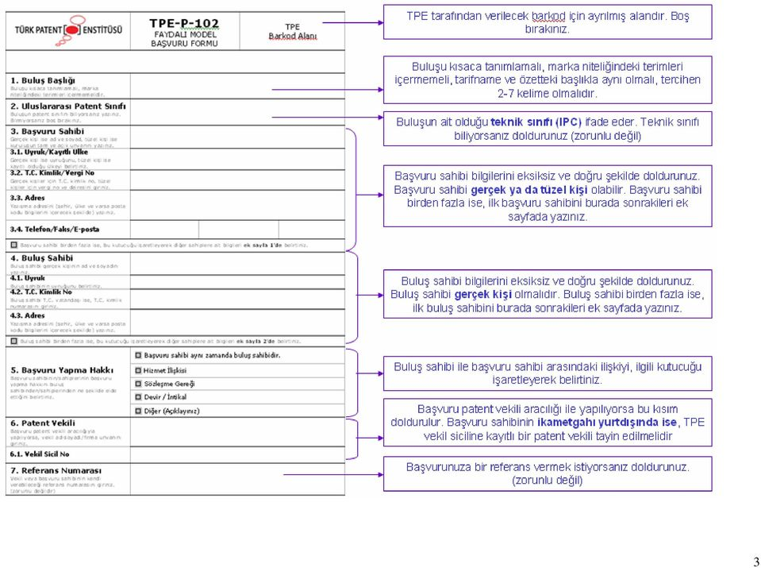
Patent Application Example

Slide 7
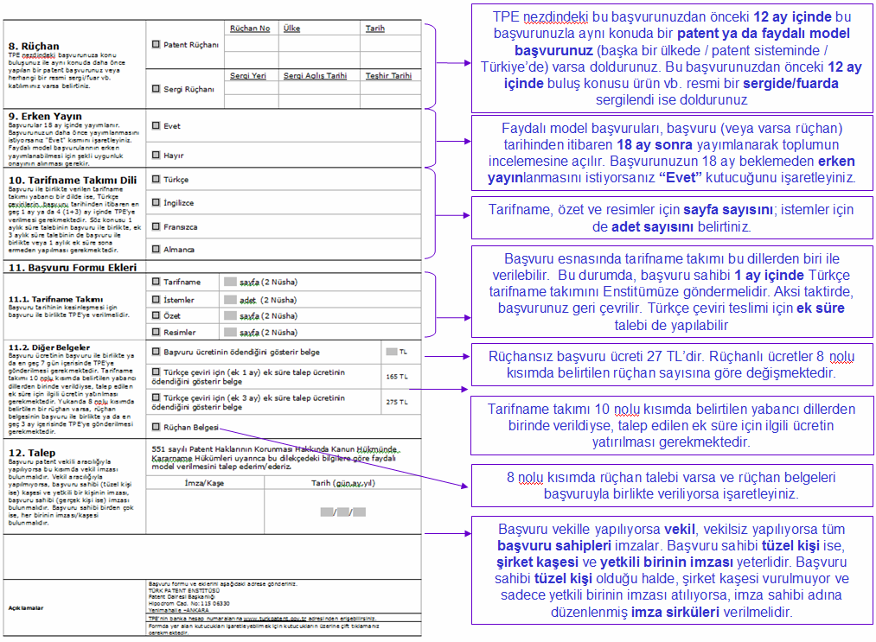

Slide 8
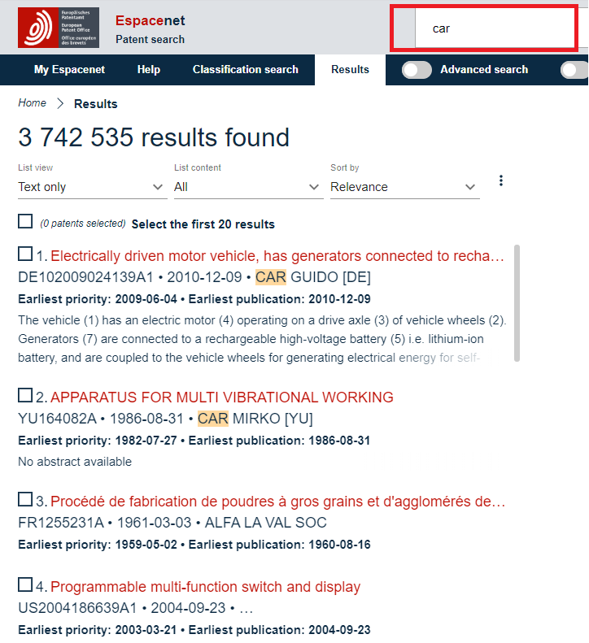

Notes:
.I would like to mention about the current patent search applicaitons.The most well-known of these sites are WIPO, Espacenet, USPto and TPE. These sites allow you to search for patents using specific phrases. This example shows our search over espacenet.

Slide 9

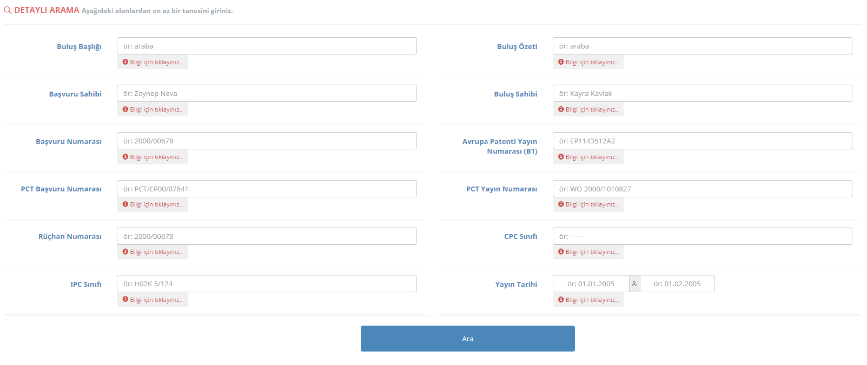
Notes:
In the search system provided to users on the TPE website, it is possible to search for patents issued according to many different criteria (title of the invention, name of inventor, IPC class etc).so as you can see these sites allow you to choose from existing patents using keywords.According to our research, there is no application to find similarity between patents

Slide 10
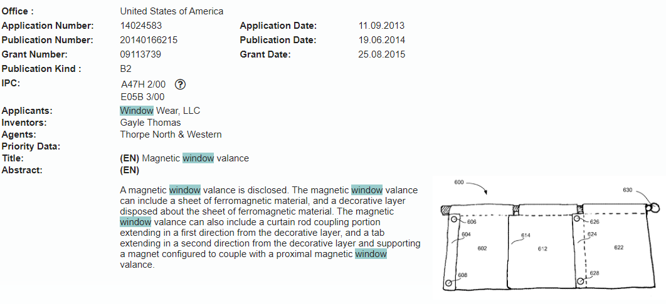
Notes:
The full version of this patent application is available in the file.
This document provides a basic description of what the invention is and a picture of what the invention looks like.
As in this example, an invention may take more than one IPC value.

Slide 11
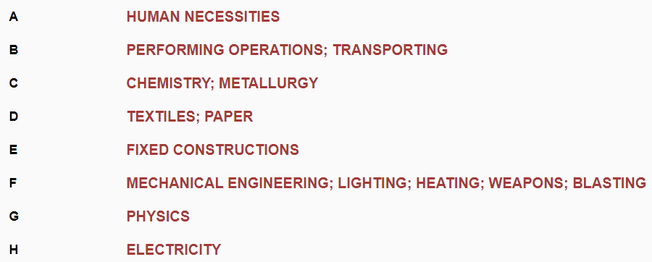
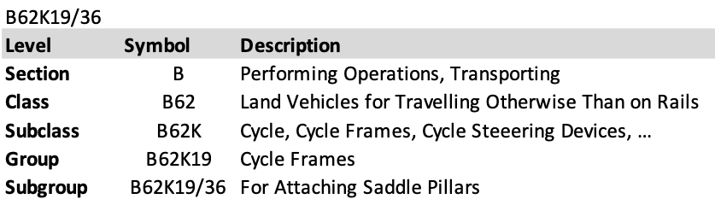
What Is IPC (International Patent Classification)
[5]
[6]
Notes:
IPC provides a hierarchical system of symbols, independent of words in different languages, for the classification of patents and utility models according to different areas of technology. Thus, the confusion that may occur with the use of different national patent classification systems is prevented and patent documents are classified in one and the same way.The IPC divides the technology into eight sections (A-H) that contain about 70,000(seventythousand)subgroups, and each subgroup has a symbol consisting of numbers and letters.In thıs example ınventıon has section B and it has class B62 . And class has the subclass. and ıt gooes on .

Slide 12
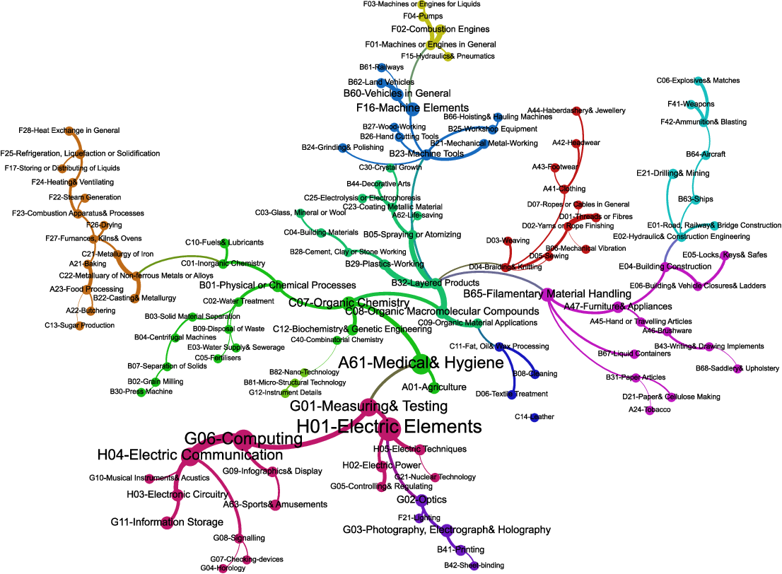
The IPC contains about 70.000 subgroups
Notes:
So, the patent classification includes too many subgroups. If we process our data according to these subclasses, we will lose a lot of time.To prevent this and make time saving, we will make our own classification

Slide 13

PROJECT CONSTRUCTION STEPS
Data Analysis
Keyword Extraction
Text Summarization
Notes:
our project has three, main steps. These are,

Slide 14

Notes:
The first job we did in the project was to review the data.
The portion to which we want to find a similarity ratio is the detailed description part of the invention.
As you can see in the file , the description sections can be very long. The longer the descriptions, the longer the comparison time.
So the first step we will next do is to summarize the definition part.
now simay will contiunue to explain progress of project

Slide 15
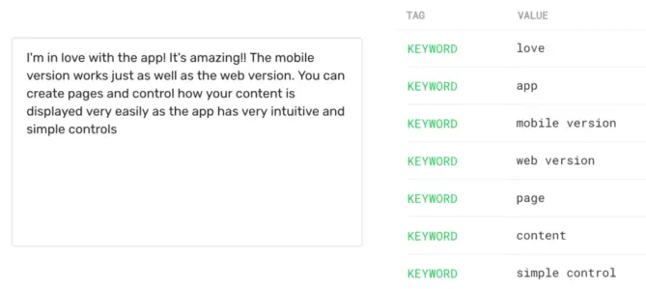
KEYWORDS EXTRACTION

Slide 16
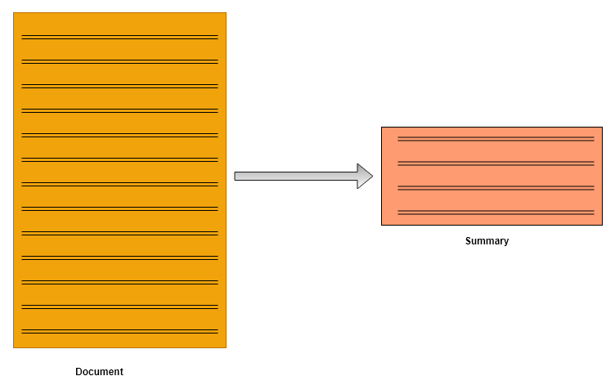
TEXT SUMMARIZATION
Notes:
Text summarization refers to the technique of shortening long pieces of text. The intention is to create a coherent and fluent summary having only the main points outlined in the document.

Slide 17
Notes:
In machine learning, extractive summarization usually involves weighing the essential sections of sentences and using the results to generate summaries.Different types of algorithms and methods can be used to gauge the weights of the sentences and then rank them according to their relevance and similarity with one another—and further joining them to generate a summary. Here's an example:

Slide 18
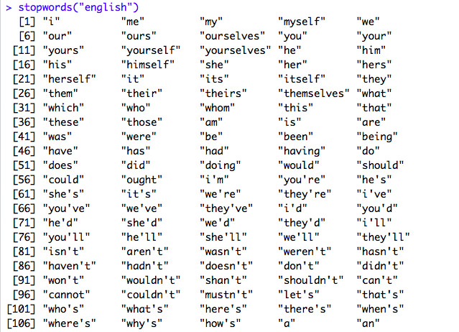

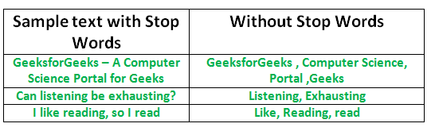
STOP WORDS
Notes:
BURADA KELIME AGACLARI BAHSEDILECEK.Datamızı buna göre temizleyeceğimizdfen

Slide 19
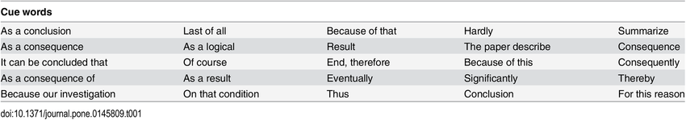
CUE WORDS
Notes:
BURADA KELIME AGACLARI BAHSEDILECEK.Datamızı buna göre temizleyeceğimizdfen

Slide 20
USER PRIVILEGES
USERS
Will be able to see the 10 most similar patents and rates compared.
Will be able to see the contents of the patents compared.
The support line will allow the user to contact us.
GUEST
You will only see the similarity ratio.

Slide 21

WEBSITE DESIGN
https://wideo.co/view/27671281578770219957?utm_source=CopyPaste&utm_medium=share&utm_campaign=sharebox
Notes:
burda sitenini misafır ve ana kullancısının haklarından bahsedilcek SITENIN VIDEOSU UZERINDEN ANLATILACAK

Slide 22
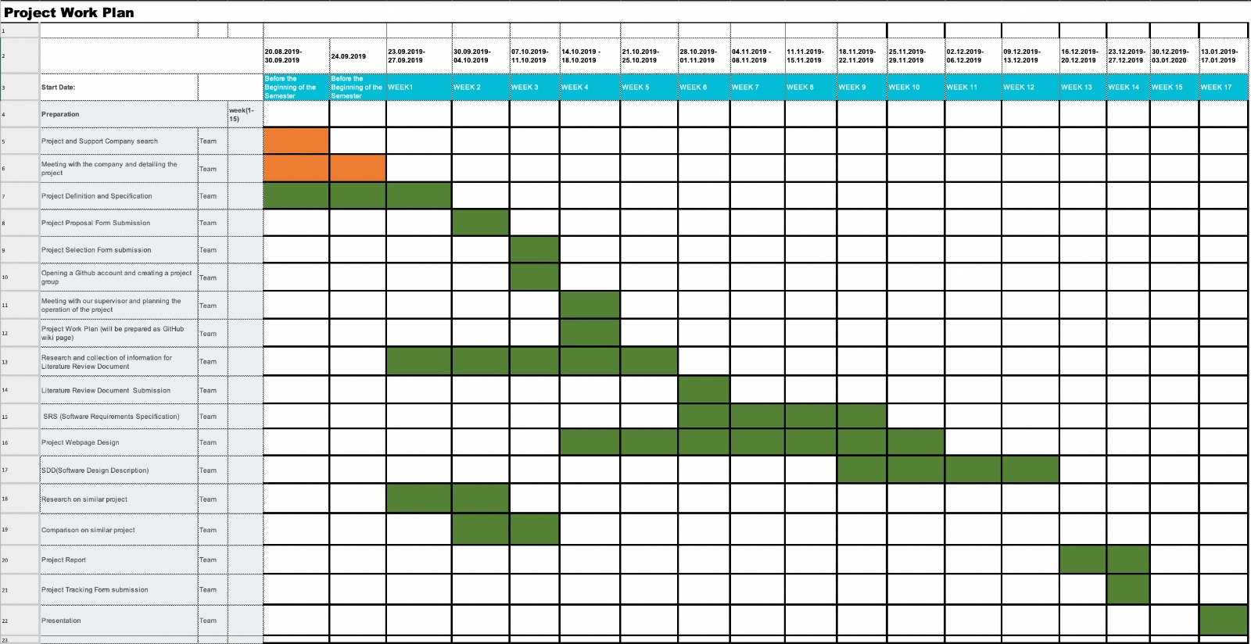
PROJECT WORK PLAN AND GANTT CHART

Slide 23
CONCLUSION
In this project that we are currently working on, some specific points cannot be considered as a whole, but should be dealt with in parts. The most important thing between these sections is how similar a patent is to the relevant patents. The first thing we do is to classify patents correctly according to IPC numbers. After classification, the titles and contents of the patents will be compared with each other. This project aims to reduce the required manpower and time allocated to this work.
Notes:
In this project that we are currently working on, some specific points can not be handled as a whole instead they should be dealt in parts. The most important thing among these parts is how much a patent is similar to related patents. The first thing that we will do is correctly classify the patents according to their IPC numbers. After the classification, the titles and content of the patents will be compared with each other. The basis will be critical similarity level that we have defined after the results obtained from a survey that targets patent holders. A report containing similarity levels of the patents will be presented to the user. In today's world researches for patents are still carried out by humans. This project aims to decrease the required manpower and time that is allocated to this business.

Slide 24
REFERENCES
[1]Sample of cue word list
https://www.researchgate.net/figure/Sample-of-cue-word-list_fig6_289523948
[2]NLTK's list of english stopwordshttps://gist.github.com/sebleier/554280
[3]https://blog.floydhub.com/gentle-introduction-to-text-summarization-in-machine-learning/
[4]https://medium.com/@umerfarooq_26378/text-summarization-in-python-76c0a41f0dc4
[5]IPC number
https://www.wipo.int/classifications/ipc/ipcpub/?notion=scheme&version=20200101&symbol=none&menulang=en&lang=en&viewmode=f&fipcpc=no&showdeleted=yes&indexes=no&headings=yes&notes=yes&direction=o2n&initial=A&cwid=none&tree=no&searchmode=smart
[6]Subgroup
http://patentwiki.iamip.com/ipc-international-patent-classification

Slide 25

QUESTION ?

